Slide 1
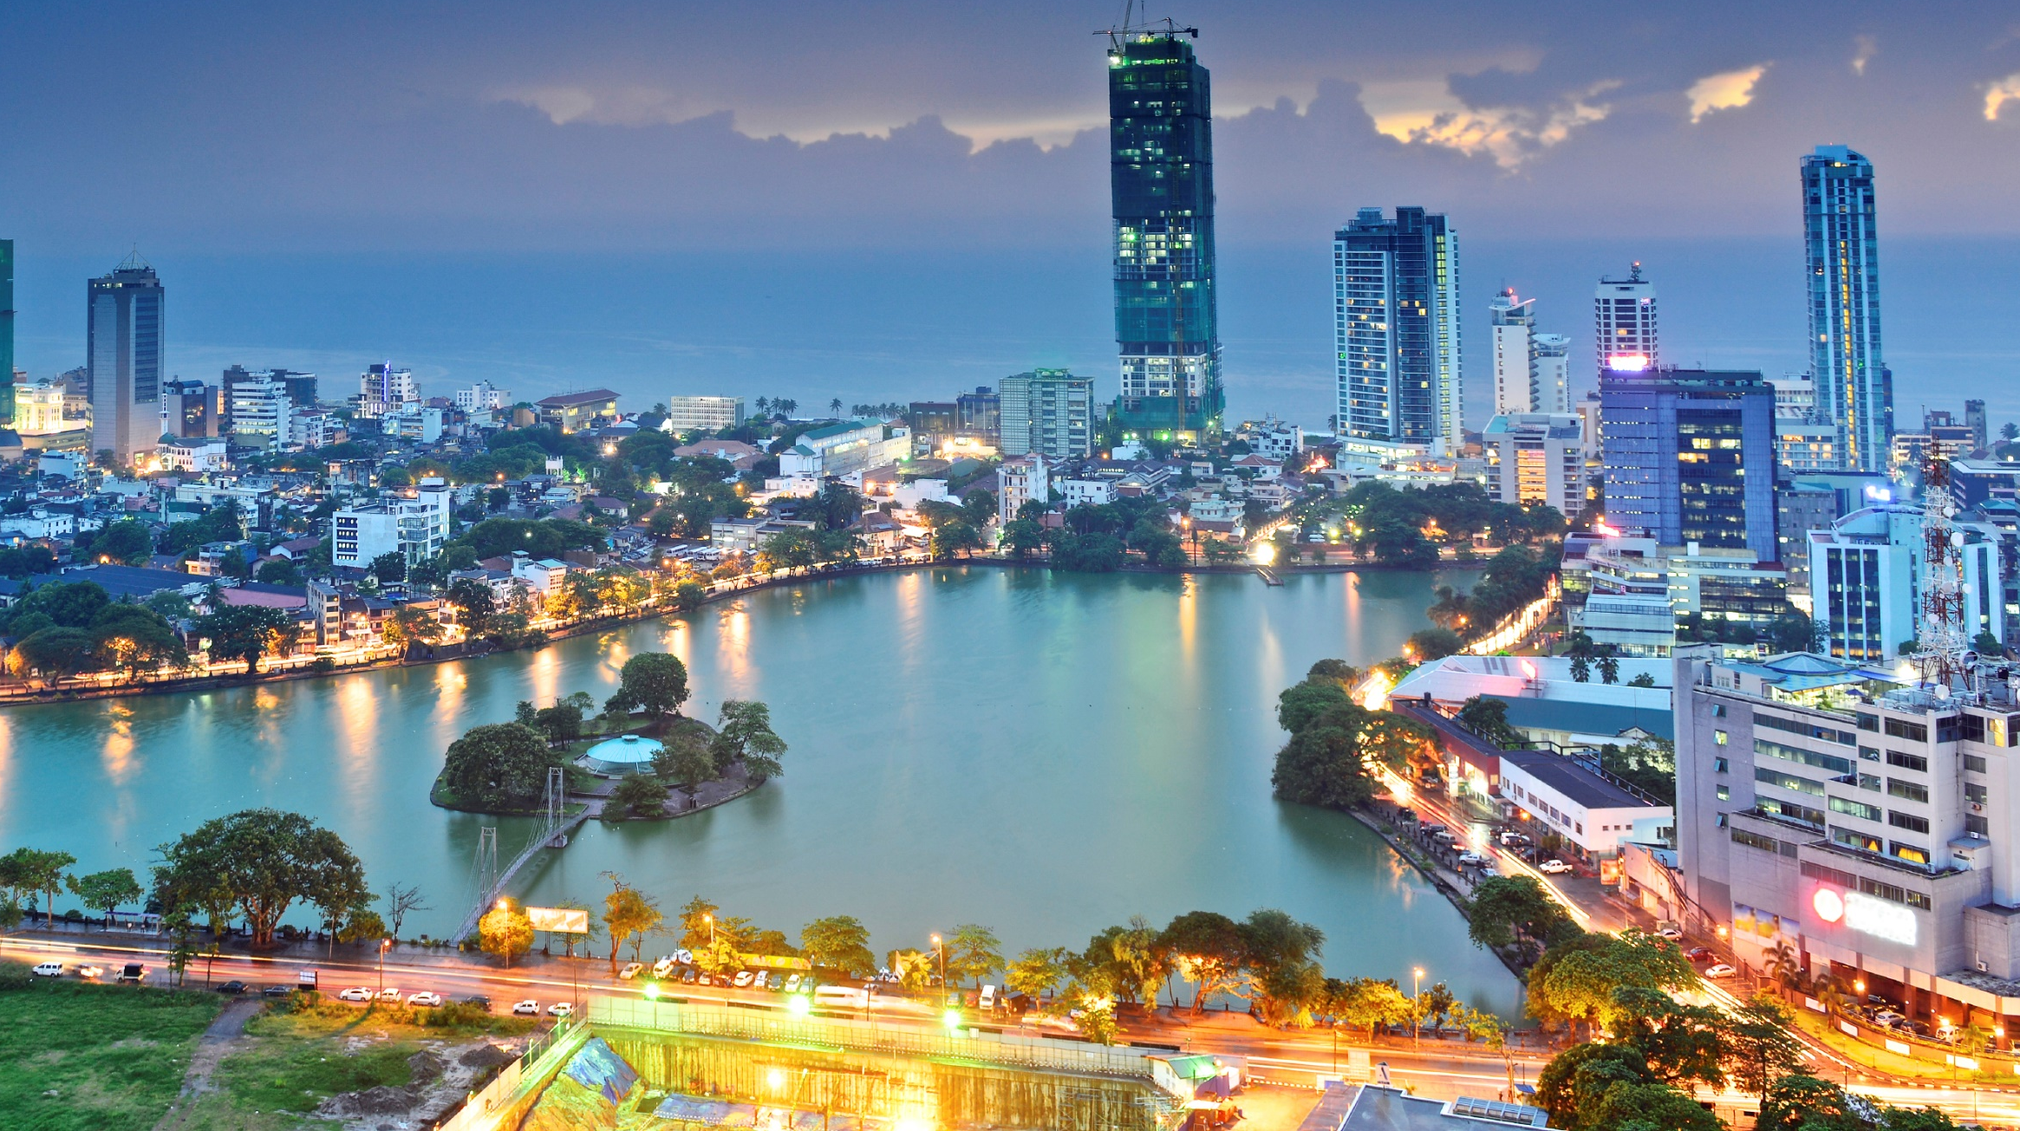
SRI LANKA
AN EMERGING ECONOMY IN SOUTH ASIA

Slide 2

AN EDUCATIONAL PRESENTATION BY THE
MINISTRY OF
FOREIGN AFFAIRS

Slide 3

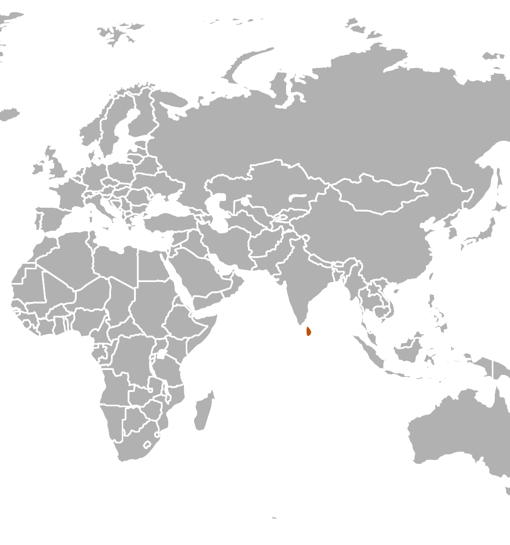

SRI LANKA AT A GLANCE
COMMERCIAL CAPITAL
COLOMBO
LAND AREA
65,610 KM
2
POPULATION (2015)
21 MILLION
GDP (2015)
COLOMBO
USD 82 BILLION
PER CAPITA INCOME (2015)
USD 3,924
Notes:
Source:
Annual Report, 2015, Central Bank of Sri Lanka, available at: http://www.cbsl.gov.lk/pics_n_docs/10_pub/_docs/efr/annual_report/AR2015/English/content.htm

Slide 4
STRUCTURE
Political Environment
Policy Framework
Macroeconomic Performance
Economic Infrastructure
Social Infrastructure
Future Outlook

Slide 5
POLITICAL
ENVIRONMENT

Slide 6
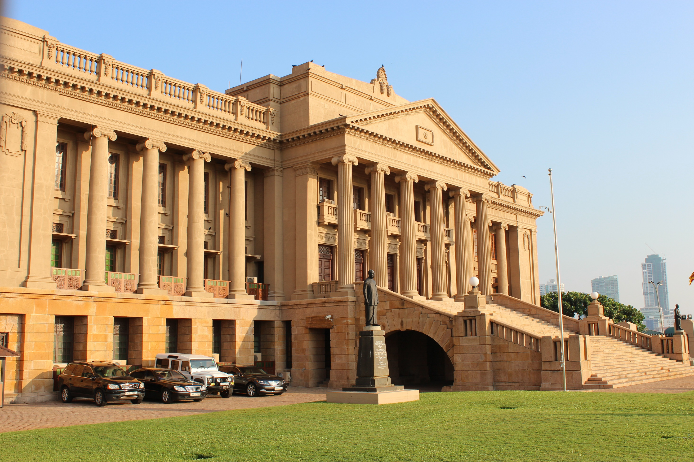
Independent since 1948
One of Asia’s oldest democracies

Slide 7
POLITICAL STRUCTURE
Executive Presidency
Parliament
- Westminster style

Slide 8
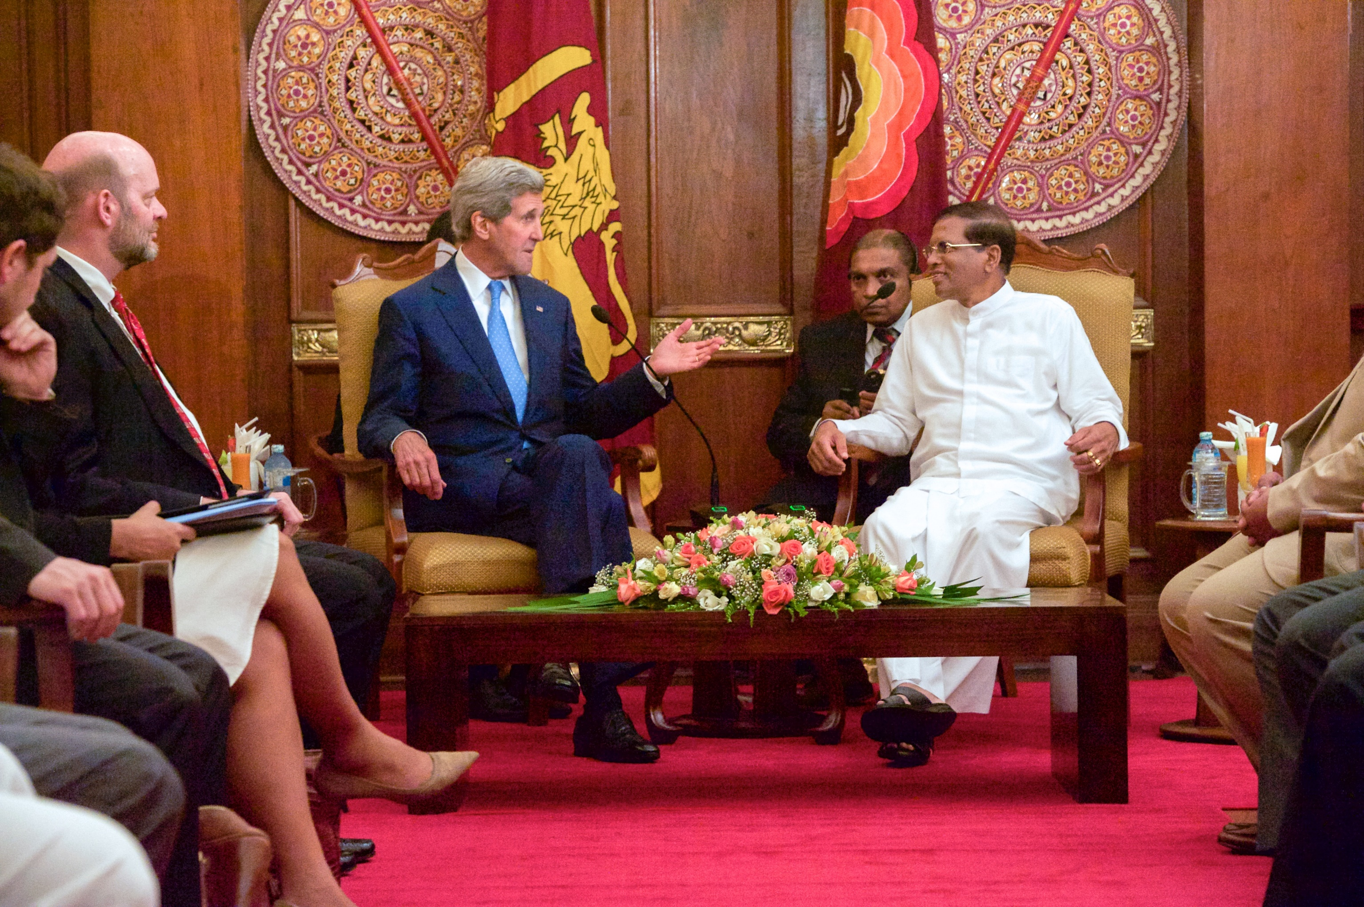
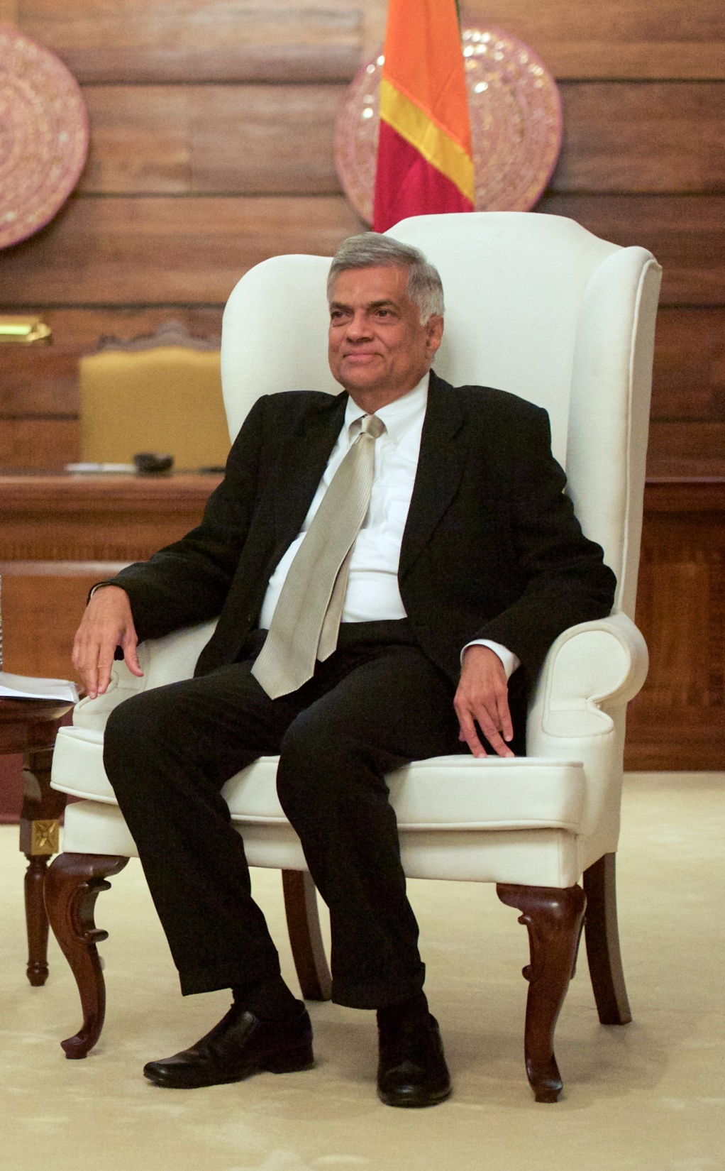
Unity Government pledged to:
Improve access to information
Enact National Audit Act
Introduce code of ethics for members of parliament
Introduce anti-corruption & anti-bribery legislation
Strengthen law enforcement
H.E. Maithripala Sirisena
President
Ranil Wickremasinghe
Prime Minister

Slide 9
POLICY FRAMEWORK
Market centred knowledge economy
Foreign policy aimed at economic diplomacy
Export and FDI driven economy
Establishment of economic development mega zones
Rapid employment generation
Institutional
reforms
Improve fiscal management
Strengthen the education and health systems

Slide 10
MACROECONOMIC PERFORMANCE

Slide 11



A SERVICE CENTRED ECONOMY
Structure of the Economy
2015 (% of GDP)
AGRICULTURE
9%
SERVICES
60%
INDUSTRIES
31%
Source: Annual Report 2015, Central Bank of Sri Lanka
Notes:
Source:
Annual Report, 2015, Central Bank of Sri Lanka, available at: http://www.cbsl.gov.lk/pics_n_docs/10_pub/_docs/efr/annual_report/AR2015/English/content.htm

Slide 12
A RESILIENT ECONOMY
Real GDP Growth
(% Change)
P- Provisional
Source: Annual Report 2015, Central Bank of Sri Lanka
Notes:
Source:
Annual Report, 2015, Central Bank of Sri Lanka, available at: http://www.cbsl.gov.lk/pics_n_docs/10_pub/_docs/efr/annual_report/AR2015/English/content.htm

Slide 13
RAPID GROWTH IN PER CAPITA INCOME
Per Capita GDP
(Current Market Prices, USD)
3,853
3,924
4,000
3,610
3,351
3,500
3,129
3,000
2,744
2,500
2,054
2,011
2,000
1,614
1,423
1,500
1,000
500
0
2006
2007
2008
2009
2010
2011
2012
2013
2014
2015
Source: Annual Report 2015, Central Bank of Sri Lanka
Notes:
Source:
Annual Report, 2006-2015, Central Bank of Sri Lanka, available at: http://www.cbsl.gov.lk/htm/english/10_pub/p_1.html

Slide 14
MODERATE GROWTH AMONG REGIONAL ECONOMIES
Average Real GDP Growth
2011 – 2015 (%)
Source: World Economic Outlook April 2016, International Monetary Fund
Notes:
Sources:
World Economic Outlook April 2016, International Monetary Fund, available at: https://www.imf.org/external/pubs/ft/weo/2016/01/weodata/index.aspx, http://www.imf.org/external/pubs/ft/weo/2016/01/

Slide 15








SERVICES LEADING GROWTH
Average Growth of Key Growth Sectors
2011-2015 (% Change)
Information Technology
Financial Services
Construction
Real Estate
Tourism
Manufacturing
Transportation
Wholesale and retail trade
Source: National Accounts Statistics 2015, Department of Census and Statistics of Sri Lanka
Notes:
Sources:
National Accounts Statistics 2015, Department of Census and Statistics of Sri Lanka, available at: http://www.statistics.gov.lk/page.asp?page=National%20Accounts

Slide 16
INVESTMENTS MAINTAINED
AT A HEALTHY LEVEL
Total Investment
(% of GDP)
Source: Budget Speech 2016, Ministry of Finance and Annual Report 2015, Central Bank of Sri Lanka
Notes:
Sources:
Budget Speech 2016, Ministry of Finance, available at: http://www.treasury.gov.lk/documents/10181/28027/Budget+Speech+2016/b2757019-9ba4-494c-9e5a-a5c2964ecdde?version=1.1
Annual Report 2015, Central Bank of Sri Lanka, available at: http://www.cbsl.gov.lk/pics_n_docs/10_pub/_docs/efr/annual_report/AR2015/English/content.htm

Slide 17
INVESTMENT OUTPERFORMING REGIONAL COMPETITORS
Total Investment
2013 (% of GDP)
Source: World Economic Outlook Database, Oct 15, International Monetary Fund
Notes:
Sources:
World Economic Outlook Database, Oct 15, International Monetary Fund, available at: https://www.imf.org/external/pubs/ft/weo/2015/02/weodata/index.aspx

Slide 18
FOCUS ON FOREIGN DIRECT INVESTMENT
FDI Inflows
(USD Millions)
P- Provisional
Source: Annual Report 2015, Central Bank of Sri Lanka
Notes:
Sources:
Annual Report 2015, Central Bank of Sri Lanka, available at: http://www.cbsl.gov.lk/pics_n_docs/10_pub/_docs/efr/annual_report/AR2015/English/content.htm

Slide 19
INFLATION AT A LOW LEVEL
Headline Inflation
(Monthly Year-on-Year, % Change)
Inflation
(Annual Year-on-Year, % Change)
Source: Inflation and Prices, Department of Census and Statistics of Sri Lanka
Source: International Financial Statistics, International Monetary Fund
Notes:
Sources:
Inflation and Prices, Department of Census and Statistics of Sri Lanka, available at: http://www.statistics.gov.lk/page.asp?page=Inflation%20and%20Prices
International Financial Statistics, International Monetary Fund, available at: http://data.imf.org/?sk=5DABAFF2-C5AD-4D27-A175-1253419C02D1

Slide 20
COMPETITIVE INTEREST RATES
Lending Rates
(%)
Source: International Financial Statistics, International Monetary Fund
Notes:
Sources:
International Financial Statistics, International Monetary Fund, available at: http://data.imf.org/?sk=5DABAFF2-C5AD-4D27-A175-1253419C02D1

Slide 21
NARROWING TRADE DEFICIT
Exports, Imports and Trade Balance
(% of GDP)
2010
2011
2012
2013
2014
2015
Source: Annual Report 2015,Central Bank of Sri Lanka
Notes:
Sources:
Annual Report 2015, Central Bank of Sri Lanka, available at: http://www.cbsl.gov.lk/pics_n_docs/10_pub/_docs/efr/annual_report/AR2015/English/content.htm

Slide 22



KEY EXPORTS
2015 (% of GDP)
Telecom and Computer Services
5%
TOTAL EXPORTS
USD 17 MN
(20% of GDP)
Tea
8%
Transport
Services
12%
Travel Services
18%
Textile & Garments
29%
Source: Annual Report 2015, Central Bank of Sri Lanka
Notes:
Sources:
Annual Report 2015, Central Bank of Sri Lanka, available at: http://www.cbsl.gov.lk/pics_n_docs/10_pub/_docs/efr/annual_report/AR2015/English/content.htm

Slide 23




KEY IMPORTS
2015 (% of GDP)
Transport
Services
7%
Food &
Beverages
TOTAL IMPORTS
USD 23 MN
(28% of GDP)
10%
Textile
10%
Machinery & Equipment
12%
Fuel
12%
Source: Annual Report 2015, Central Bank of Sri Lanka
Notes:
Sources:
Annual Report 2015, Central Bank of Sri Lanka, available at: http://www.cbsl.gov.lk/pics_n_docs/10_pub/_docs/efr/annual_report/AR2015/English/content.htm

Slide 24
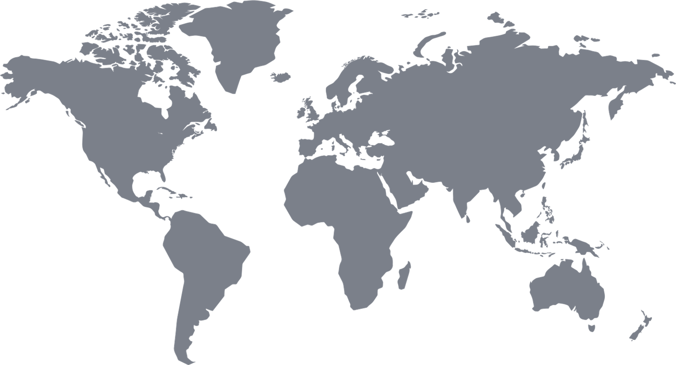
TOP 5 EXPORT MARKETS
2015 (% of total exports)
USA
EU
27%
29%
UAE
3%
CHINA
3%
INDIA
6%
Source: Annual Report 2015, Central Bank of Sri Lanka
Notes:
Sources:
Annual Report 2015, Central Bank of Sri Lanka, available at: http://www.cbsl.gov.lk/pics_n_docs/10_pub/_docs/efr/annual_report/AR2015/English/content.htm

Slide 25
TOP 5 IMPORT MARKETS
2015 (% of total exports)
JAPAN
EU
7%
9%
UAE
6%
CHINA
20%
INDIA
23%
Source: Annual Report 2015, Central Bank of Sri Lanka
Notes:
Sources:
Annual Report 2015, Central Bank of Sri Lanka, available at: http://www.cbsl.gov.lk/pics_n_docs/10_pub/_docs/efr/annual_report/AR2015/English/content.htm

Slide 26
MOVING TOWARDS A COMPETITIVE EXCHANGE RATE
Monthly Average Exchange Rate
Jan 15-May 16, (LKR/USD)
Movement of Selected Currencies vs USD
May 15- May 16, (% change)
MYR | Malaysian Ringgit
LKR | Sri Lankan Rupee
GBP | British Pound
THB | Thai Baht
CNY | Chinese Yuan
INR | Indian Rupee
VND | Vietnamese Dong
SGD | Singaporean Dollar
PKR | Pakistani Rupee
BDT | Bangladeshi Taka
KHR | Cambodian Riel
AED | UAE Dirham
EUR | Euro
Source: External Sector Statistics, Central Bank of Sri Lanka
Source: Country Specific Monetary Authorities
Notes:
Sources:
External Sector Statistics, Central Bank of Sri Lanka, available at: http://www.cbsl.gov.lk/htm/english/08_stat/s_3.html

Slide 27
EXTERNAL RESERVES WITHIN COMFORT ZONE DESPITE A DECLINE
Gross Official Reserves
Gross Official Reserves
Months of Import
Source: Weekly Economic Indicators, Central Bank of Sri Lanka
Notes:
Sources:
Weekly Economic Indicators, Central Bank of Sri Lanka, available at: http://www.cbsl.gov.lk/htm/english/_cei/ei/e_1.asp

Slide 28
FISCAL CONSOLIDATION IS A PRIORITY
Government Fiscal Operations
(% of GDP)
Government Finance
2014 (% of GDP)
E- Estimate
P- Provisional
Source: Annual Report 2015, Central Bank of Sri Lanka
Source: World Economic Outlook Database, Oct 15, International Monetary Fund
Notes:
Sources:
Annual Report 2015, Central Bank of Sri Lanka, available at: http://www.cbsl.gov.lk/pics_n_docs/10_pub/_docs/efr/annual_report/AR2015/English/content.htm
World Economic Outlook Database, Oct 15, International Monetary Fund, available at: https://www.imf.org/external/pubs/ft/weo/2015/02/weodata/index.aspx

Slide 29
BRINGING DEBT UNDER CONTROL
Outstanding Government Debt
2006-2015 (% of GDP)
Gross Government Debt
2014 (% of GDP)
Source: Annual Report 2015, Central Bank of Sri Lanka
Source: World Economic Outlook Database, Oct 15, International Monetary Fund
Notes:
Sources:
Annual Report 2015, Central Bank of Sri Lanka, available at: http://www.cbsl.gov.lk/pics_n_docs/10_pub/_docs/efr/annual_report/AR2015/English/content.htm
World Economic Outlook Database, Oct 15, International Monetary Fund, available at: https://www.imf.org/external/pubs/ft/weo/2015/02/weodata/index.aspx

Slide 30
ECONOMIC INFRASTRUCTURE

Slide 31


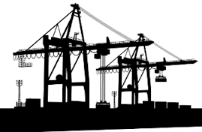


INFRASTRUCTURE - FORGING AHEAD
3 expressways (170 km) in the last 5 years
3rd terminal of Colombo Port added 2.4 million TEU in 2013
Recently
completed
key projects
A new international port constructed in the South, 10 km from the main maritime route connecting East & West
22% increase in energy generation, 2010 - 2015
2nd international airport at Mattala in 2013 added passenger capacity
by 1 million
Source: Central Bank of Sri Lanka, Sri Lanka Ports Authority and Airport and Aviation Services (Pvt) Ltd
Notes:
Sources:
Central Bank of Sri Lanka, available at: http://www.cbsl.gov.lk/index.asp
Sri Lanka Ports Authority, available at: http://www.slpa.lk/
Airport and Aviation Services (Pvt) Ltd, available at: http://www.airport.lk/#page=page-1, http://www.airport.lk/aasl/contact_us/contact_details.php

Slide 32

2
Best in South Asia for Overall Quality of National Infrastructure
124
BANGLADESH
Overall Quality of National Infrastructure 2015
(rank out of 140 countries)
PHILIPPINES
106
102
CAMBODIA
VIETNAM
99
74
INDIA
THAILAND
71
#1
IN
SOUTH ASIA
26
SRI LANKA
MALAYSIA
16
Source: Global Competitiveness Report 2015-2016, World Economic Forum
Notes:
Sources:
Global Competitiveness Report 2015-2016, World Economic Forum, available at: http://www3.weforum.org/docs/gcr/2015-2016/Global_Competitiveness_Report_2015-2016.pdf

Slide 33




Sri Lanka
MOBILE PENETRATION
(Subscriptions
per 100 persons)
India, Pakistan,
Bangladesh
South Asia
INTERNET PENETRATION
(Users per 100 persons)
ECONOMIC INFRASTRUCTURE
ACCESS TO ELECTRICITY
(Subscriptions
per 100 persons)
ACCESS TO
FINANCE
(Number of branches
per 100,000 adults)
Source: Road Development Authority, Economic and Social Statistics 2015, Central Bank of Sri Lanka, World Bank Database 2014/12, Household Income and Expenditure Survey 2012/13, Department of Census and Statistics of Sri Lanka 2012 , UNDP Human Development Report 2012.
Notes:
Sources:
Road Development Authority, available at: http://www.rda.gov.lk/
Economic and Social Statistics 2015, Central Bank of Sri Lanka, available at: http://www.cbsl.gov.lk/htm/english/10_pub/p_2.html
World Bank Database 2014/12, available at: http://databank.worldbank.org/data/home.aspx
Household Income and Expenditure Survey 2012/13, Department of Census and Statistics of Sri Lanka, available at: http://www.statistics.gov.lk/HIES/HIES2012_13FinalReport.pdf, http://www.statistics.gov.lk/page.asp?page=Income%20and%20Expenditure
UNDP Human Development Report 2012, available at: http://hdr.undp.org/en

Slide 34
SOCIAL INFRASTRUCTURE

Slide 35
Human Development
similar to high income countries
1st
55%
0.48
in South Asia on the Human Development Index
Reduction in Poverty Head Count Index
(2006/07-2012/13)
Gini-coefficient
of household income
(2012/13)
Source: World Development Indicators, World Bank, Central Bank of Sri Lanka Annual Report
Notes:
Sources:
World Development Indicators, World Bank, available at: http://data.worldbank.org/data-catalog/world-development-indicators, http://databank.worldbank.org/data/reports.aspx?source=world-development-indicators
Central Bank of Sri Lanka Annual Report, available at: http://www.cbsl.gov.lk/htm/english/10_pub/p_1.html

Slide 36
MALAYSIA
73
62
SRI LANKA
THAILAND
HIGH HUMAN DEVELOPMENT
PHILIPPINES
93
Human Development
Index Ranking
2015 (out of 188 countries)
VIETNAM
116
INDIA
115
BANGLADESH
143
130
CAMBODIA
142
Source: Human Development Report 2015, United Nations Development Programme
Notes:
Sources:
Human Development Report 2015, United Nations Development Programme, available at: http://report.hdr.undp.org/

Slide 37


SOCIAL INFRASTRUCTURE: EDUCATION
LITERACY RATE
(15+, % of population, 2015)
MEAN YEARS OF SCHOOLING (of adults, years) (2013)
THAILAND | 96.7
PHILIPPINES | 96.3
MALAYSIA | 94.6
VIETNAM | 94.5
SRI LANKA | 92.6
CAMBODIA | 77.2
INDIA | 72.1
BANGLADESH | 61.6
SRI LANKA | 10.8
MALAYSIA | 9.5
PHILIPPINES | 8.9
THAILAND | 7.3
CAMBODIA | 5.8
VIETNAM | 5.5
BANGLADESH | 5.1
INDIA | 4.4
Source: Human Development Report 2015, United Nations Development Programme, UNESCO Institute for Statistics, 2015 estimates, UNDP 2013
Notes:
Sources:
Human Development Report 2015, United Nations Development Programme, available at: http://report.hdr.undp.org/
UNESCO Institute for Statistics, 2015 estimates, available at: http://www.uis.unesco.org/Pages/default.aspx
UNDP 2013, available at: http://hdr.undp.org/en/2013-report

Slide 38
SOCIAL INFRASTRUCTURE: HEALTH
LIFE EXPECTANCY AT BIRTH
(Years, 2015)
MATERNAL MORTALITY
(Deaths per 100,000
live births, 2015)
IMPROVED SANITATION
(% of population
with access, 2015)
VIETNAM | 75.8
SRI LANKA | 74.2
THAILAND | 74.2
BANGLADESH | 71.2
MALAYSIA | 68.1
PHILIPPINES | 68.1
CAMBODIA | 67.8
INDIA | 67.7
THAILAND | 20
SRI LANKA | 30
MALAYSIA | 40
VIETNAM | 54
PHILIPPINES | 114
CAMBODIA | 161
INDIA | 174
BANGLADESH | 176
MALAYSIA | 96%
SRI LANKA | 95%
THAILAND | 93%
VIETNAM | 78%
PHILIPPINES | 74%
BANGLADESH | 61%
CAMBODIA | 42%
INDIA | 40%
Source: World Development Indicators, World Bank, Trends in Maternal Mortality 1990 – 2015, UNICEF
Notes:
Sources:
World Development Indicators, World Bank, available at: http://data.worldbank.org/data-catalog/world-development-indicators
Trends in Maternal Mortality 1990 – 2015, UNICEF, available at: http://www.unicef.org/eapro/MMR_executive_summary_final_mid-res.pdf

Slide 39
LABOUR AND EMPLOYMENT
65% Male
54%
35% Female
Labour Force
Participation
rate
27%
Industry
4.6%
Share of
Employed
45%
Services
Unemployment
Rate
28%
Agriculture
Source: Annual Labour Force Survey 2014, Department of Census and Statistics of Sri Lanka, World Development Indicators, World Bank
Notes:
Sources:
Annual Labour Force Survey 2014, Department of Census and Statistics of Sri Lanka, available at: http://www.statistics.gov.lk/samplesurvey/LFS_Annual%20Report_2014.pdf, http://www.statistics.gov.lk/page.asp?page=Labour%20Force
World Development Indicators, World Bank, available at: http://data.worldbank.org/data-catalog/world-development-indicators

Slide 40
LABOUR FORCE AT ITS LARGEST
Source: Census of Population and Housing (various years), Department of Census and Statistics of Sri Lanka
Notes:
Sources:
Census of Population and Housing (various years), Department of Census and Statistics of Sri Lanka, available at: http://www.statistics.gov.lk/page.asp?page=Population%20and%20Housing

Slide 41
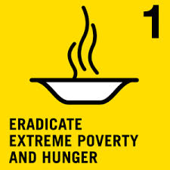







SOCIAL INFRASTRUCTURE
MILLENNIUM DEVELOPMENT GOALS
Maternal mortality ratio declined from 92 to 33 during 1990 - 2010 (per 100,000 live births)
Halved poverty 7 years
before target year
Net enrolment in primary schools 99.3% in 2009
A low prevalence country
Gender parity in primary education 99.4% in 2012 (ratio of girls to boys)
Total forest cover fallen by 6.4% during 1990-2010
(of total land area)
Reducing mortality rates
by two-thirds by 2015
Achieved target for safe drinking water and basic sanitation
Source: MDG Country Report 2014, UN Sri Lanka
Notes:
Sources:
MDG Country Report 2014, UN Sri Lanka, available at: http://countryoffice.unfpa.org/srilanka/drive/MDG-Country-Report-2014.pdf

Slide 42
FUTURE OUTLOOK

Slide 43
FUTURE OUTLOOK
2016
2017
2018
2019
ECONOMIC GROWTH (%)
TOTAL INVESTMENT (% OF GDP)
AVERAGE INFLATION (%)
GOVT. REVENUE & GRANTS (% OF GDP)
FISCAL DEFICIT (% OF GDP)
CENTRAL GOVERNMENT DEBT (% OF DEBT)
GROSS OFFICIAL RESERVES (MONTHS OF IMPORTS)
Source: Sri Lanka Staff Report For The 2016 Article IV Consultation And Request For A Three-year Extended Arrangement Under The Extended Fund Facility, International Monetary Fund
Notes:
Sources:
Sri Lanka Staff Report For The 2016 Article IV Consultation And Request For A Three-year Extended Arrangement Under The Extended Fund Facility, International Monetary Fund, available at: https://www.imf.org/external/pubs/cat/longres.aspx?sk=43960.0

Slide 44
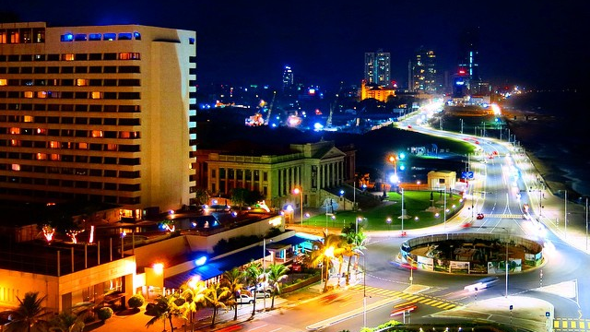
THANK YOU
Notes:
Add the name, contact details of the Embassy/Consulate

